Slide 1
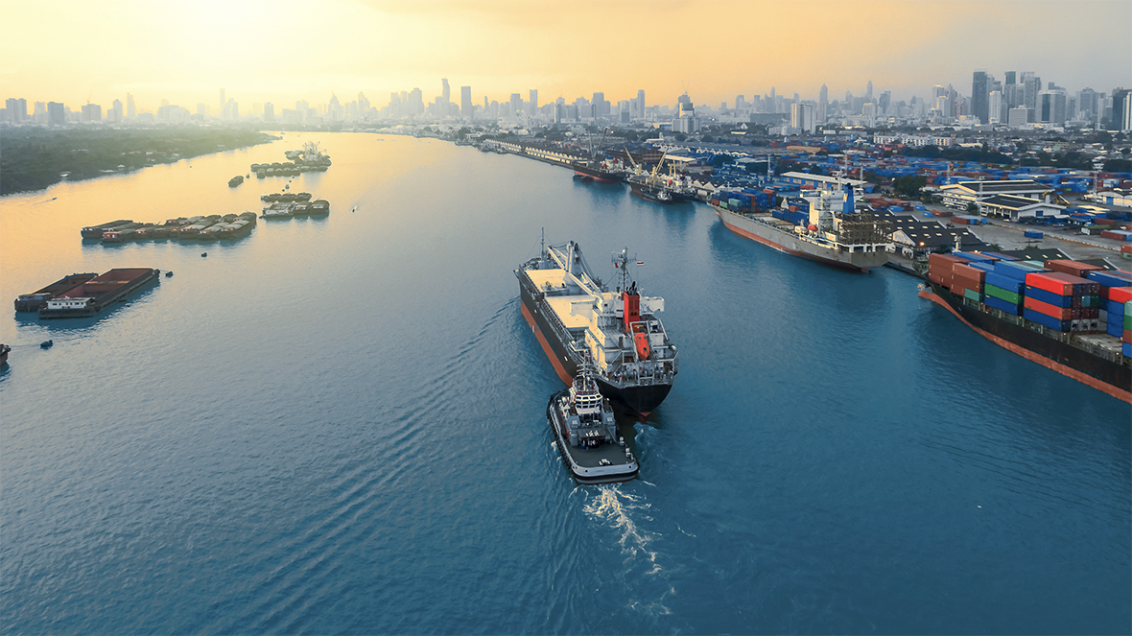


OCT 2024
Marine Port Guide

Slide 2

Disclaimer
This presentation was prepared for discussion purposes only and does not constitute an offer for any ExxonMobil product or service. No warranty or representation, express or implied, is made regarding the information contained herein and ExxonMobil shall not be responsible for any loss sustained by any person or entity who relies on this material. Exxon Mobil Corporation has numerous affiliates, many with names that include ExxonMobil, Exxon, Mobil, Esso, and XTO. For convenience and simplicity, those terms and terms such as Corporation, company, our, we, and its are sometimes used as abbreviated references to specific affiliates or affiliate groups. Abbreviated references describing global or regional operational organizations, and global or regional business lines are also sometimes used for convenience and simplicity. Nothing contained herein is intended to override the corporate separateness of affiliated companies. This material is not to be reproduced without the permission of Exxon Mobil Corporation.

Slide 3
ARA Region
Slagentangen
Bergen
Ports
Larvik
Zeebrugge
Rotterdam
Antwerp
Flushing
Poole
Portsmouth
Fawley
Southampton
Hong Kong
Singapore
Auckland
Wellington
Tauranga
Bluff
Lyttelton

Slide 4
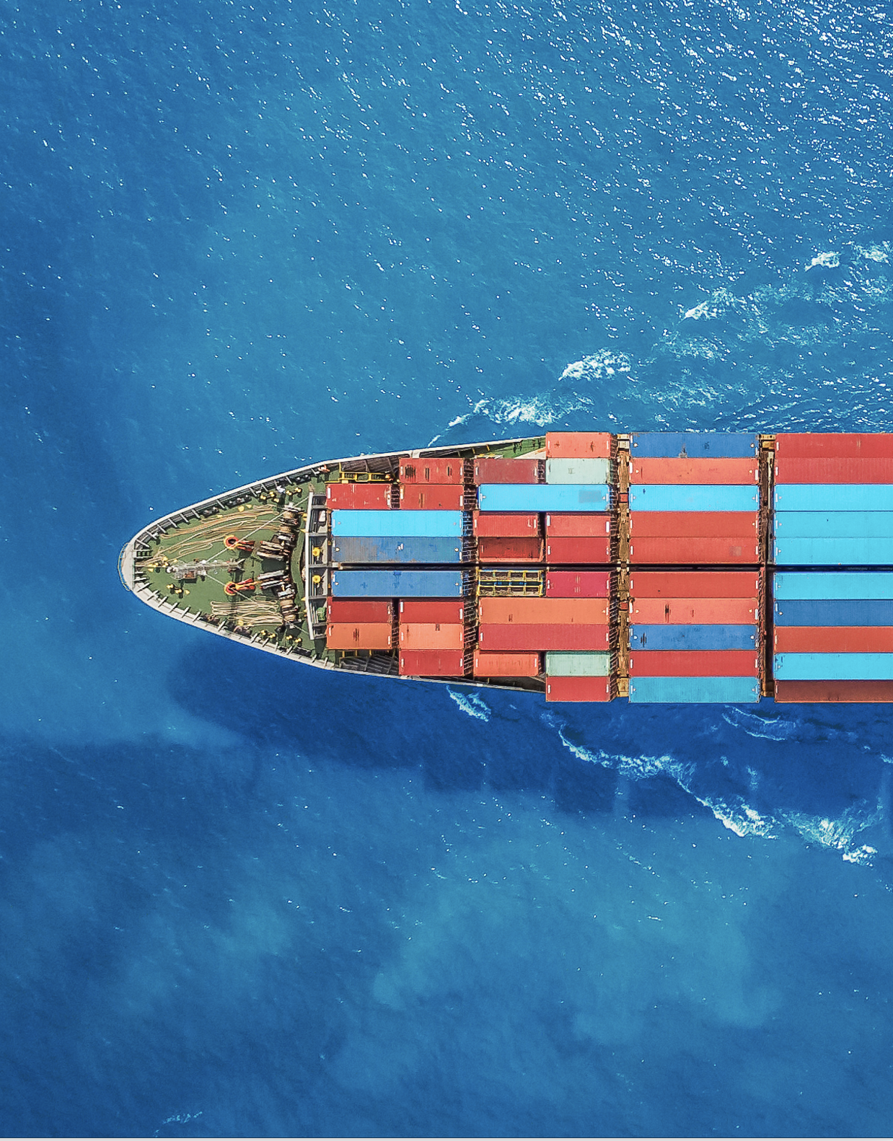
Marine Port Guide
Quality, Reliability, Integrity
ExxonMobil has more than 50 years of experience in supplying high-quality fuels to the marine industry.
Our high-quality fuels help deliver consistent performance to vessel owners and operators worldwide. We maintain high standards of integrity and ethics across our operations to help provide peace of mind and enable owners and operators to deliver reliably.¹
About ports in ARA
Europe's largest bunkering hub
Strategic connectivity to northwest Europe
¹ Marine Fuel Commitment to Quality | ExxonMobil Marine

Slide 5

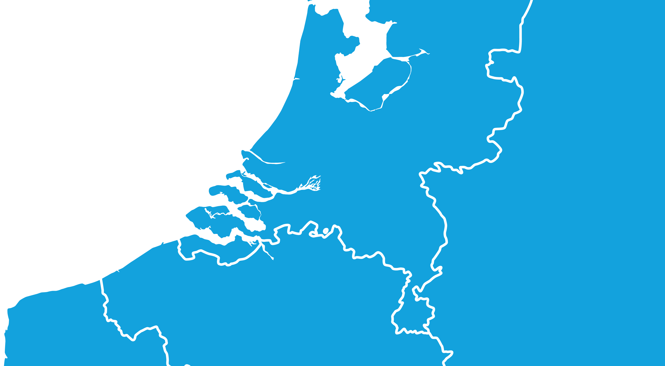


Marine Port Guide
Delivery Ports of ARA
ExxonMobil in ARA
Antwerp and Rotterdam refineries produce low Sulphur content fuels with combined capacity of 495,000 barrels/day.
Netherlands
Dedicated barging capability in ARA ports, including estuary barges in ports like Zeebrugge.
Rotterdam
Flushing
Zeebrugge
Antwerp
First to supply ECA-compliant fuel via an independently accredited mass flow metering system (MFMS) in 2018.
Belgium
Unique branded fuels offer:
ExxonMobil is also present in the following delivery ports:
EMF.5TM low-sulphur marine fuels – Engineered Marine Fuels 0.5%S
ExxonMobil Premium HDME 50TM fuel – ECA-compliant fuel
Terneuzen
Moerdijk
Ghent
Dordrecht
Sluiskil
Alternative fuels offer:
Drop-in Bio Marine Fuel Blends offer

Slide 6



Product Offer
ExxonMobil offers a range of options for vessel operators compliant with the IMO Sulphur cap requirements and meeting ISO8217:2017 (except the FAME component which meets EN14214 for Bio Marine Fuel Blends)
Contact our international sales team for more information about our fuel offerings at ARA ports
Europe (Brussels)
Email: marine.fuels@exxonmobil.com
Asia Pacific
Email: DS-F&L-AP-MARINE@exxonmobil.com
Visit us at:
Exxonmobil.com
Linkedin.com

Slide 7
Product Information – Conventional Fuels
ExxonMobil offers a range of options for vessel operators compliant with the IMO Sulphur cap requirements and meeting ISO8217:2017
 | EMF.5TM (RMG 380) | EM Premium HDME 50TM (exceeding RMD 80) | MGO (DMA)
Sulphur content | Max 0.50% | Max 0.10% (ECA) | Max 0.10%
Viscosity | Formulated to meet OEM requirements | 30-45 cSt at 50°C | 2-6 cSt at 40°C
Flash Point | Min 60°C | Min 70°C | Min 60°C
AI + Si, mg/kg | Max 60ppm | <5ppm | N/A
Delivery Method | Barge | Barge | Barge
Info | Can safeguard engines running on 3.50% sulphur fuels; range offers improved combustion while minimising waxing | No residual material; cleaner engines compared to HSFO, no cat-fines and low ash build up in engine; excellent ignition quality; excellent lubricity | Minimum requirement for fuel treatment; no heating requirement
Website link | EMF.5TM (pdf) | EM Premium HDME 50TM | MGO (pdf)
Contact our international sales team for more information about our fuel offerings at ARA ports
Europe (Brussels)
Email: marine.fuels@exxonmobil.com
Asia Pacific
Email: DS-F&L-AP-MARINE@exxonmobil.com
Visit us at:
Exxonmobil.com
Linkedin.com

Slide 8
Product Information – Bio Marine Fuel Blends
ExxonMobil offers a range of options for vessel operators compliant with the IMO requirements and meeting ISO8217:2017 (except the FAME component which meets EN14214)
 | BIO-VLSFO (except FAME) | BIO – ECA FUEL (except FAME)
Sulphur content | Max 3.50% | Max 0.10% (ECA)
Viscosity | Formulated to meet OEM requirements | Formulated to meet OEM requirements
Flash Point | Min 60°C | Min 60°C
Bio content | Max 30vol% FAME | Max 25vol% FAME
FAME | Meets EN14214 | Meets EN14214
Handling | Drop in fuel* | Drop in fuel*
Delivery Method | Barge | Barge
Info | Reduced estimated lifecycle GHG emissions compared to conventional petroleum-based liquid fuels** | Reduced estimated lifecycle GHG emissions compared to conventional petroleum-based liquid fuels**
Website | Bio Marine Fuels | Bio Marine Fuels
Contact our international sales team for more information about our fuel offerings at ARA ports
Europe (Brussels)
Email: marine.fuels@exxonmobil.com
Asia Pacific
Email: DS-F&L-AP-MARINE@exxonmobil.com
Visit us at:
*Consult with engine manufacturer. OEMs may limit bio blend percentages or specific bio components for certain engines.
**Benefit compared with conventional petroleum-based liquid marine fuels, calculated on an energy basis. Estimated well-to-wake CO2 emissions reduction calculated using Energy Directive (2018/2001/EU Annex V) (“RED II”). Actual results may very and lifecycle GHG emissions reduction can vary with each batch and will depend on factors such as the specific feedstock and production process.
Exxonmobil.com
Linkedin.com

