Slide 1
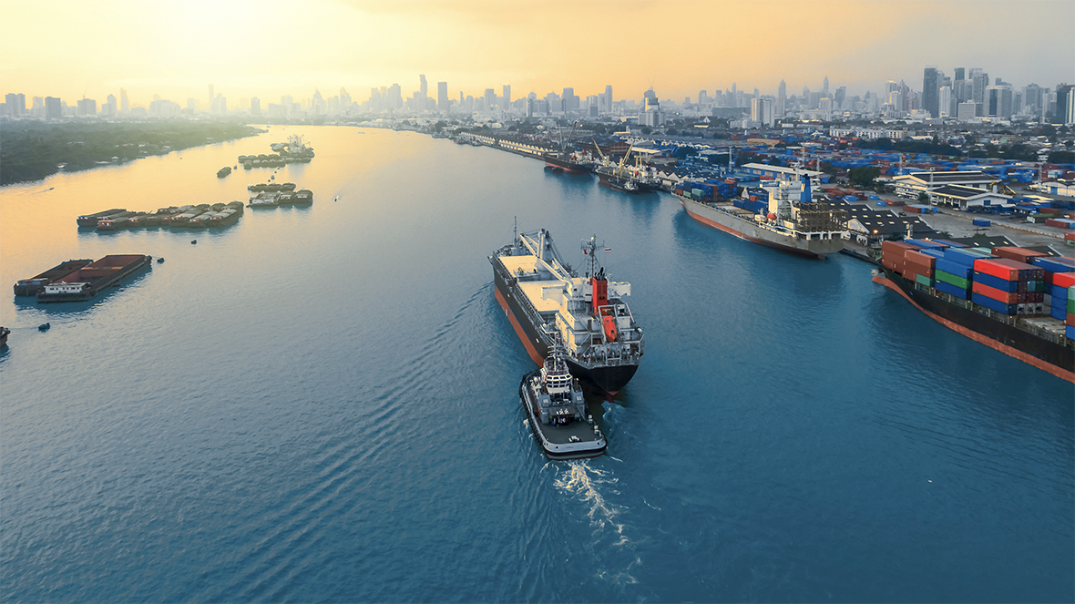

OCT 2024
Marine Port Guide
New Zealand

Slide 2

Disclaimer
This presentation was prepared for discussion purposes only and does not constitute an offer for any ExxonMobil product or service. No warranty or representation, express or implied, is made regarding the information contained herein and ExxonMobil shall not be responsible for any loss sustained by any person or entity who relies on this material. Exxon Mobil Corporation has numerous affiliates, many with names that include ExxonMobil, Exxon, Mobil, Esso, and XTO. For convenience and simplicity, those terms and terms such as Corporation, company, our, we, and its are sometimes used as abbreviated references to specific affiliates or affiliate groups. Abbreviated references describing global or regional operational organizations, and global or regional business lines are also sometimes used for convenience and simplicity. Nothing contained herein is intended to override the corporate separateness of affiliated companies. This material is not to be reproduced without the permission of Exxon Mobil Corporation.

Slide 3
New Zealand
Slagentangen
Bergen
Ports
Larvik
Zeebrugge
Rotterdam
Antwerp
Flushing
Poole
Portsmouth
Fawley
Southampton
Hong Kong
Singapore
Auckland
Wellington
Tauranga
Bluff
Lyttelton

Slide 4
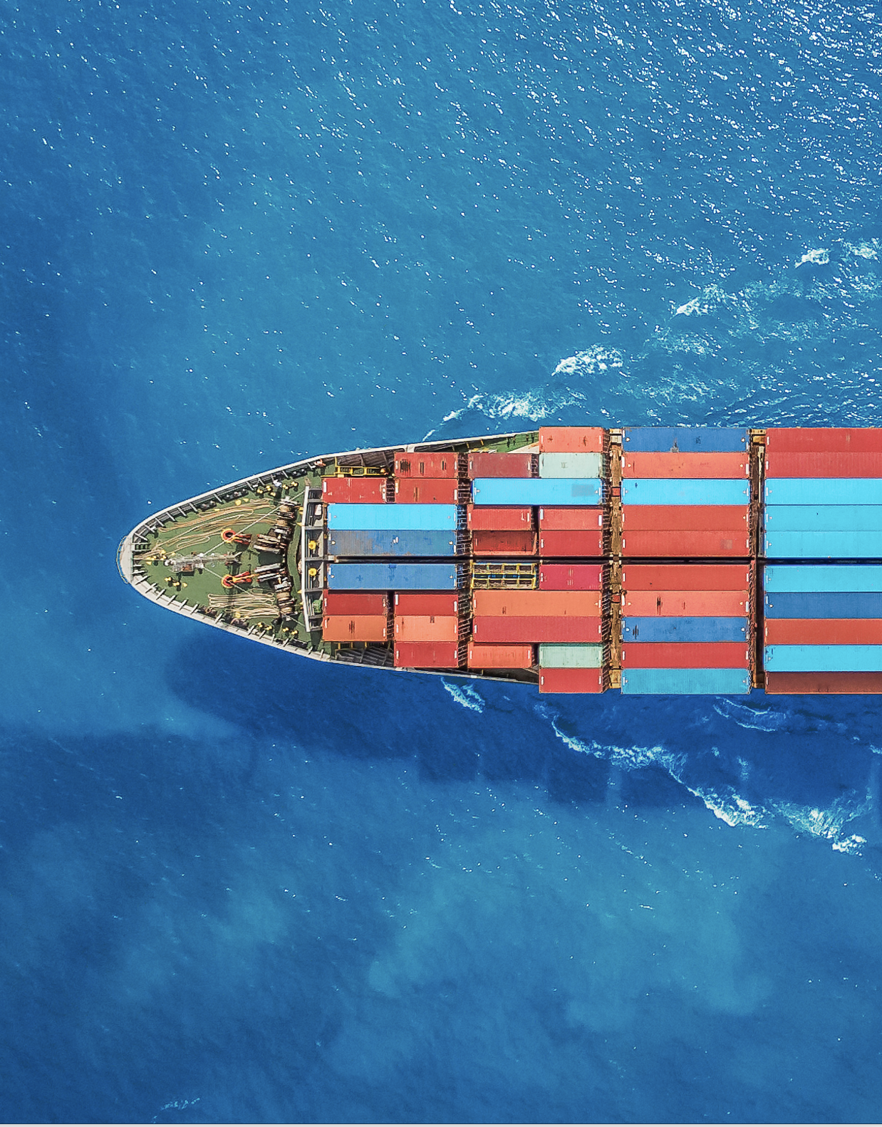
New Zealand
Marine Port Guide
Quality, Reliability, Integrity
ExxonMobil has more than 50 years of experience in supplying high-quality fuels to the marine industry.
Our high-quality fuels help deliver consistent performance to vessel owners and operators worldwide. We maintain high standards of integrity and ethics across our operations to help provide peace of mind and enable owners and operators to deliver reliably.¹
About Ports of New Zealand
Tauranga: NZ’s largest and most efficient port that operates the
country’s largest container terminal.
Auckland: Situated in the heart of the city.
Wellington: Kaiwharawhara terminal located in the heart of NZ’s
capital city; connects customers at CentrePort with their requirements.
Christchurch: Lyttelton terminal supports the South Island’s principal goods-transport port.
Bluff: NZ’s most southern commercial deepwater port
¹ Marine Fuel Commitment to Quality | ExxonMobil Marine

Slide 5

New Zealand
Marine Port Guide
Auckland
ExxonMobil in New Zealand
Tauranga (Mount Maunganui)
Ports of New Zealand
Operates Mt. Maunganui terminal (Tauranga) with capability to bunker DMA to vessels at main wharf via 7 berth locations
Wellington
Dedicated trucking capability
Experience seamless marine services at our four strategically located Mobil-owned terminals (Tauranga, Wellington, Christchurch, Bluff), where we offer efficient pipeline deliveries at three of these terminals (Tauranga, Wellington, Christchurch), for reliable supply for your marine bunkering requirements.
PAC
Christchurch
Bluff
Terminal

Slide 6



New Zealand
Product Offer
ExxonMobil offers a range of options for vessel operators compliant with the IMO Sulphur cap requirements and meeting ISO8217:2017
Port | Conventional Fuels
 | Distillate
Auckland | DMA - 0.001%S
Bluff | DMA - 0.001%S
Lyttelton | DMA - 0.001%S
Wellington | DMA - 0.001%S
Tauranga | DMA - 0.001%S
Contact our international sales team for more information about our fuel offerings at New Zealand ports
Asia Pacific
Email: DS-F&L-AP-MARINE@exxonmobil.com
Europe (Brussels)
Email: marine.fuels@exxonmobil.com
Visit us at:
Exxonmobil.com
Linkedin.com

Slide 7
New Zealand
Product Information – Conventional Fuels
ExxonMobil offers a range of options for vessel operators compliant with the IMO Sulphur cap requirements and meeting ISO8217:2017
 | MGO DMA
Sulphur content | Max 0.001%
Viscosity | 2-6 cSt at 40°C
Flash Point | Min 60°C
Al + Si, mg/kg | N/A
Delivery Method | Truck/Pipe
Info | Minimal requirement for fuel treatment; no heating requirement
Website link | DMA (pdf)
Contact our international sales team for more information about our fuel offerings at New Zealand ports
Asia Pacific
Email: DS-F&L-AP-MARINE@exxonmobil.com
Europe (Brussels)
Email: marine.fuels@exxonmobil.com
Visit us at:
Exxonmobil.com
Linkedin.com

