Slide 1
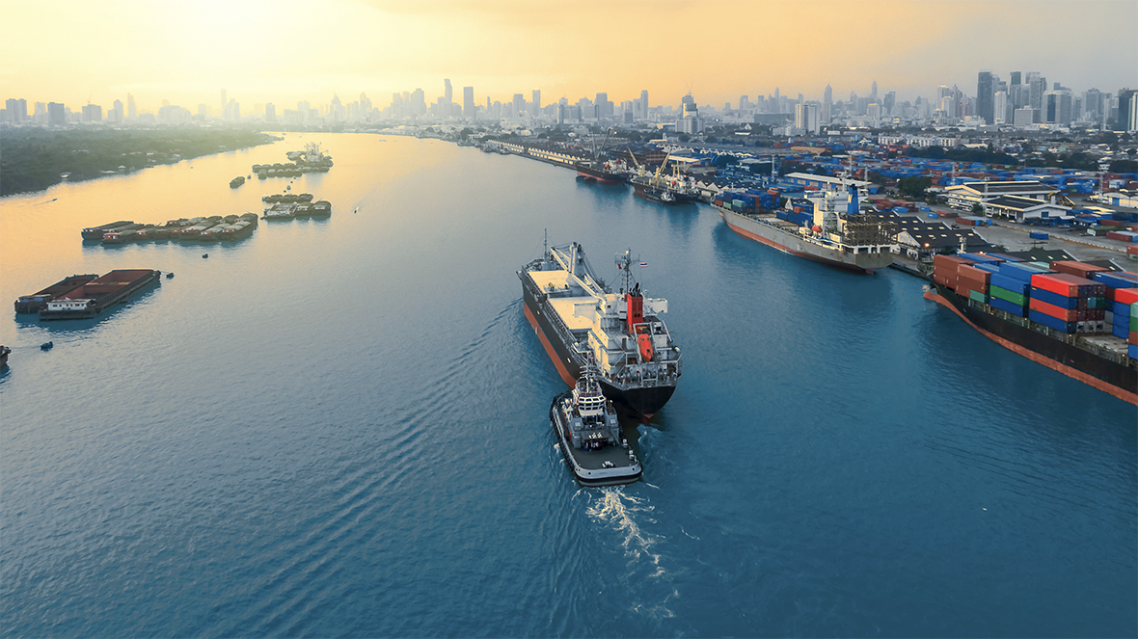

OCT 2024
Marine Port Guide
Singapore

Slide 2

Disclaimer
This presentation was prepared for discussion purposes only and does not constitute an offer for any ExxonMobil product or service. No warranty or representation, express or implied, is made regarding the information contained herein and ExxonMobil shall not be responsible for any loss sustained by any person or entity who relies on this material. Exxon Mobil Corporation has numerous affiliates, many with names that include ExxonMobil, Exxon, Mobil, Esso, and XTO. For convenience and simplicity, those terms and terms such as Corporation, company, our, we, and its are sometimes used as abbreviated references to specific affiliates or affiliate groups. Abbreviated references describing global or regional operational organizations, and global or regional business lines are also sometimes used for convenience and simplicity. Nothing contained herein is intended to override the corporate separateness of affiliated companies. This material is not to be reproduced without the permission of Exxon Mobil Corporation.

Slide 3
Singapore
Slagentangen
Bergen
Port
Larvik
Zeebrugge
Rotterdam
Antwerp
Flushing
Poole
Portsmouth
Fawley
Southampton
Hong Kong
Singapore
Auckland
Wellington
Tauranga
Bluff
Lyttelton

Slide 4
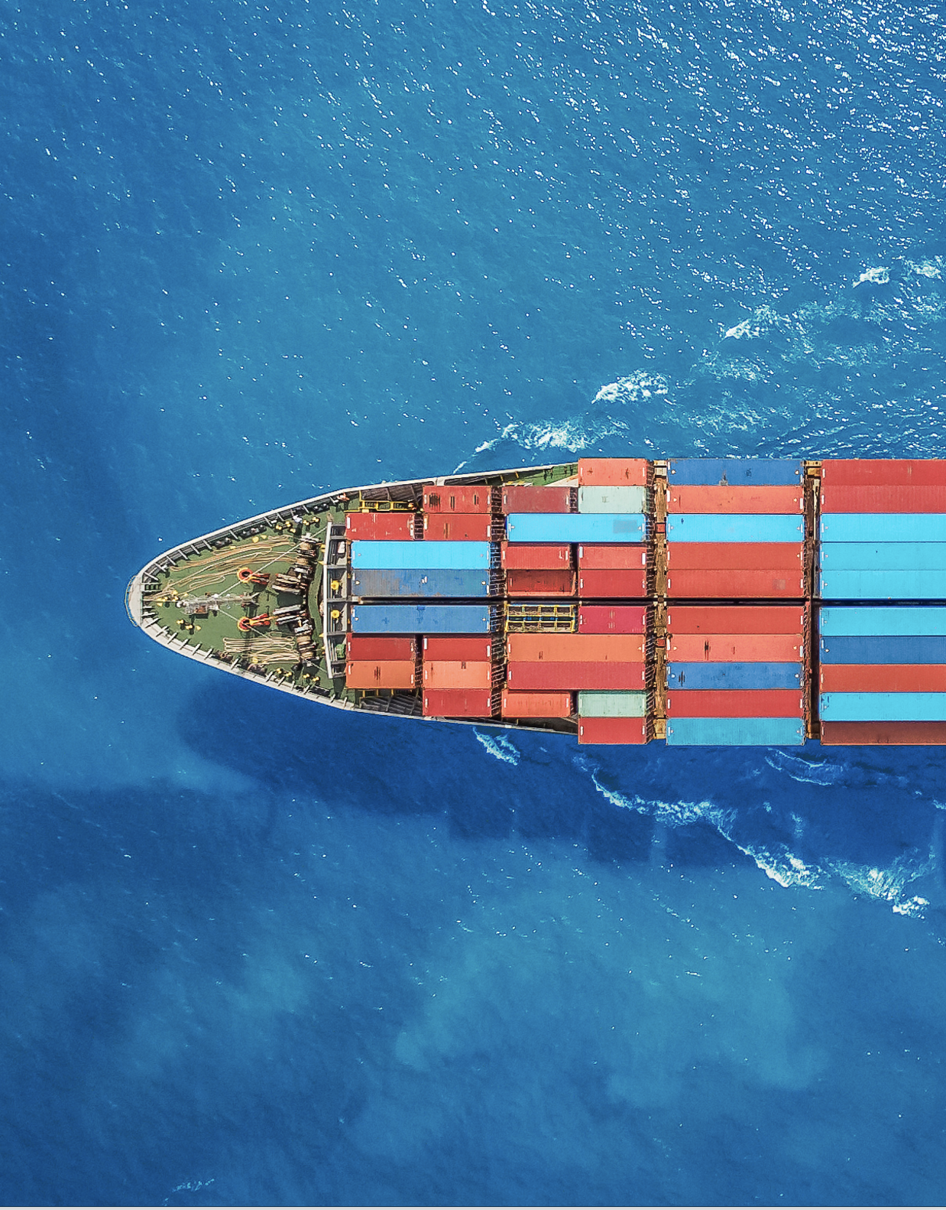
Singapore
Marine Port Guide
Quality, Reliability, Integrity
ExxonMobil has more than 50 years of experience in supplying high-quality fuels to the marine industry.
Our high-quality fuels help deliver consistent performance to vessel owners and operators worldwide. We maintain high standards of integrity and ethics across our operations to help provide peace of mind and enable owners and operators to deliver reliably.¹
About the Port of Singapore
World’s largest bunkering port
Mandatory use of MPA-approved MFM system
for all bunker deliveries
Stringent bunkering standards (SS 600, SS 524)
¹ Marine Fuel Commitment to Quality | ExxonMobil Marine

Slide 5
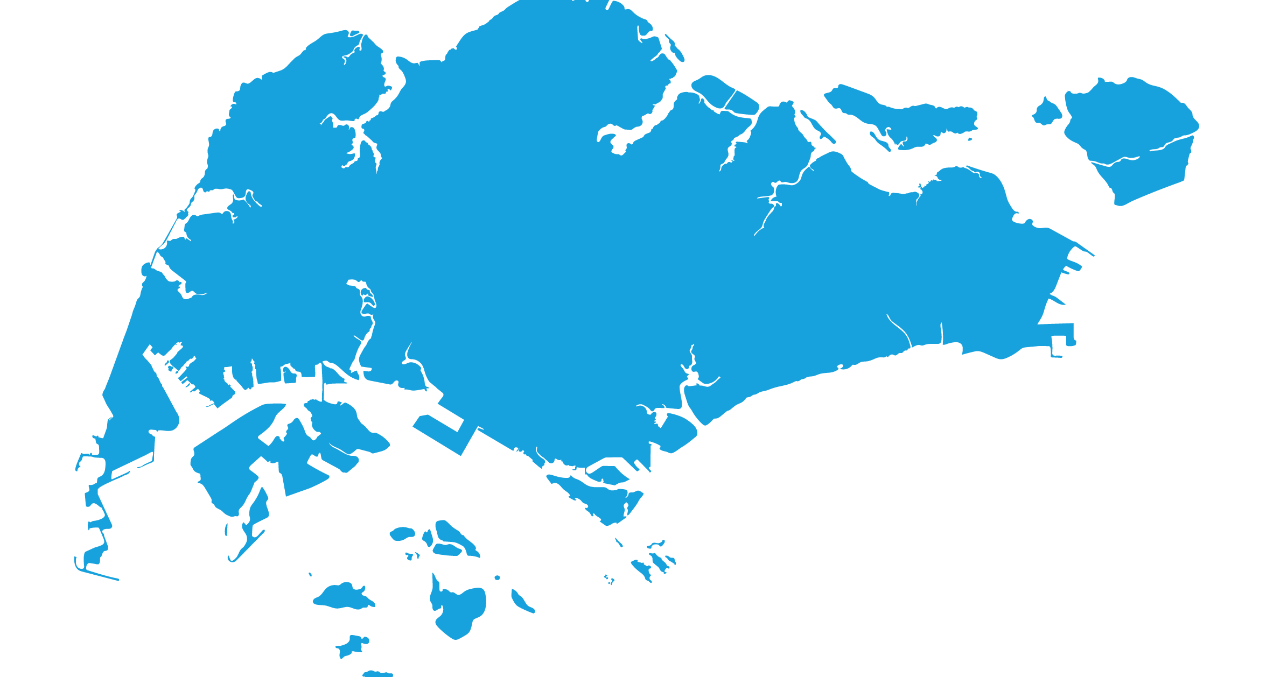



Singapore
Marine Port Guide
ExxonMobil in Singapore
Port of Singapore
Two integrated refineries with a capacity
of 592,000 barrels per day
Dedicated barging capability for multiple products
Singapore
Jurong
First to introduce mass flow metering system (MFMS) technology in 2012
PAC
Refinery
Drop-in Bio Marine Fuel Blends Offer

Slide 6



Singapore
Product Offer
ExxonMobil offers a range of options for vessel operators compliant with the IMO Sulphur cap requirements and meeting ISO8217:2017 (except the FAME component which meets EN14214 for Bio Marine Fuel Blends)
Port | Conventional fuels |  | Bio Marine Fuel blends
Singapore | VLSFO (0.5%S) | Distillate | BIO VLSFO (0.5%S)
 | Fuel Oil – RMG 380 | DMA – 0.10%S | Bio – RMG 380
Contact our international sales team for more information about our fuel offerings at the Port of Singapore
Asia Pacific
Email: DS-F&L-AP-MARINE@exxonmobil.com
Europe (Brussels)
Email: marine.fuels@exxonmobil.com
Visit us at:
Exxonmobil.com
Linkedin.com

Slide 7
Singapore
Product Information – Conventional Fuels
ExxonMobil offers a range of options for vessel operators compliant with the IMO Sulphur cap requirements and meeting ISO8217:2017
 | Fuel Oil RMG 380 | MGO DMA
Sulphur content | Max 0.50% | Max 0.10%
Viscosity | max 380 cSt at 50°C | 2-6 cSt at 40°C
Flash Point | Min 60°C | Min 60°C
AI + Si, mg/kg | Max 60ppm | N/A
Delivery Method | Barge/Ex-wharf | Barge/Ex-wharf
Info | Can safeguard engines running on 0.50% sulphur fuels; range offers improved combustion while minimising waxing | Minimal requirement for fuel treatment; no heating requirement
Website link | Fuel Oil (pdf) | DMA (pdf)
Contact our international sales team for more information about our fuel offerings at the Port of Singapore
Asia Pacific
Email: DS-F&L-AP-MARINE@exxonmobil.com
Europe (Brussels)
Email: marine.fuels@exxonmobil.com
Visit us at:
Exxonmobil.com
Linkedin.com

Slide 8
Singapore
Product Information – Bio Marine Fuel Blends
ExxonMobil offers a range of options for vessel operators compliant with the IMO requirements and meeting ISO8217:2017 (except the FAME component which meets EN14214)
 | BIO-VLSFO (except FAME)
Sulphur content | Max 0.50%
Viscosity | max 380 cSt at 50°C
Flash Point | Min 60°C
Bio content | Max 24vol% FAME
FAME | Meets EN14214
Handling | Drop in fuel*
Delivery Method | Barge
Info | Reduced estimated lifecycle GHG emissions compared to conventional petroleum-based liquid fuels**
Website | Bio Marine Fuels
Contact our international sales team for more information about our fuel offerings at the Port of Singapore
Asia Pacific
Email: DS-F&L-AP-MARINE@exxonmobil.com
Europe (Brussels)
Email: marine.fuels@exxonmobil.com
Visit us at:
*Consult with engine manufacturer. OEMs may limit bio blend percentages or specific bio components for certain engines.
**Benefit compared with conventional petroleum-based liquid marine fuels, calculated on an energy basis. Estimated well-to-wake CO2 emissions reduction calculated using Energy Directive (2018/2001/EU Annex V) (“RED II”). Actual results may very and lifecycle GHG emissions reduction can vary with each batch and will depend on factors such as the specific feedstock and production process.
Exxonmobil.com
Linkedin.com

